Slide 1
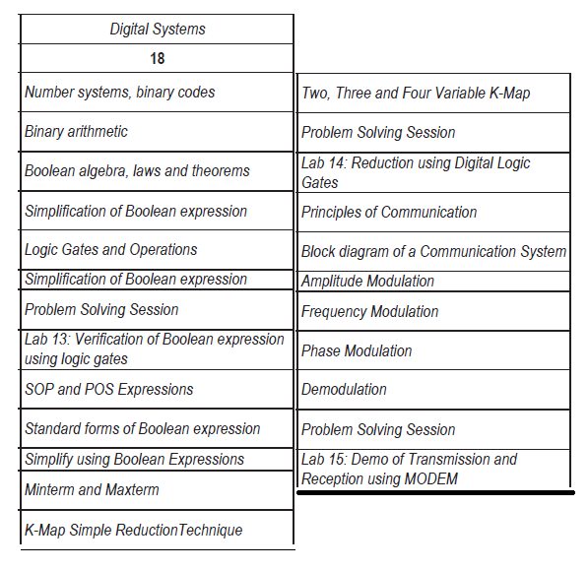
BEEE-UNIT 5

Slide 2
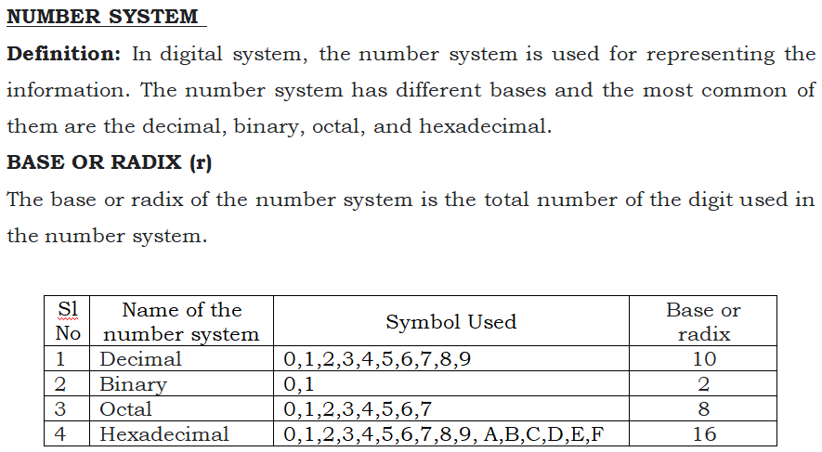

Slide 3
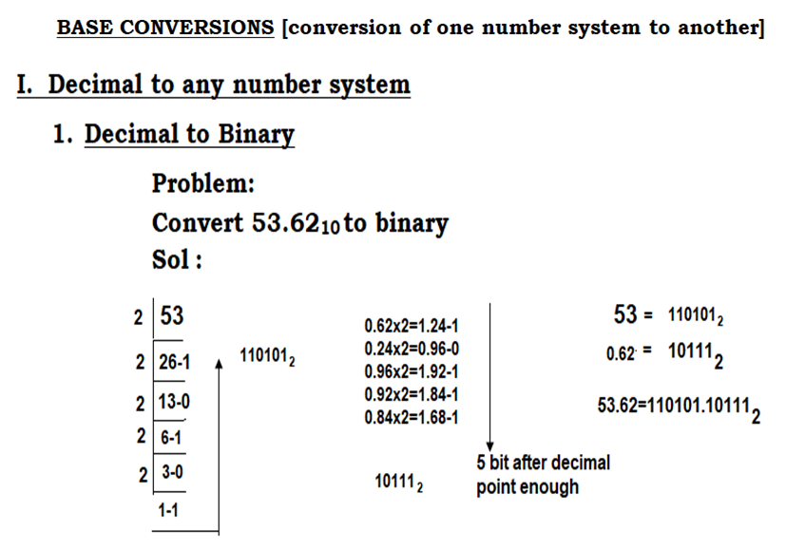

Slide 4
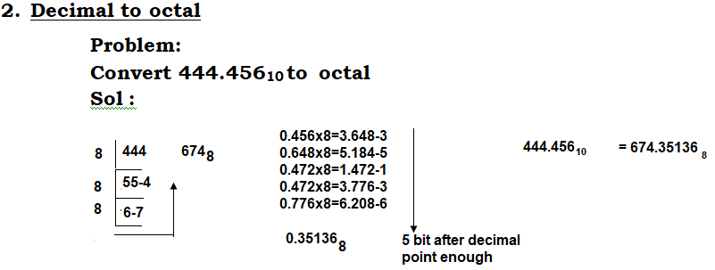
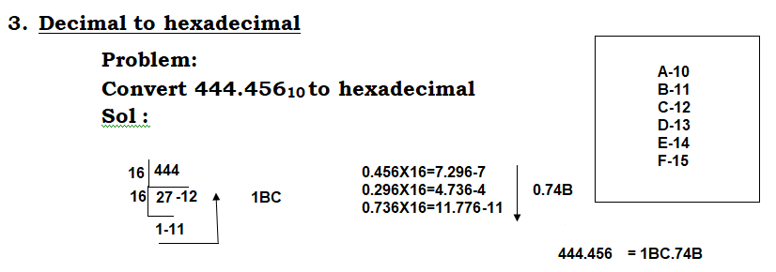

Slide 5
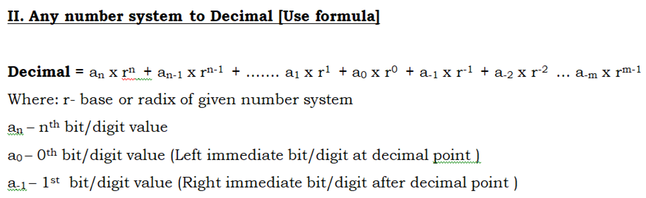
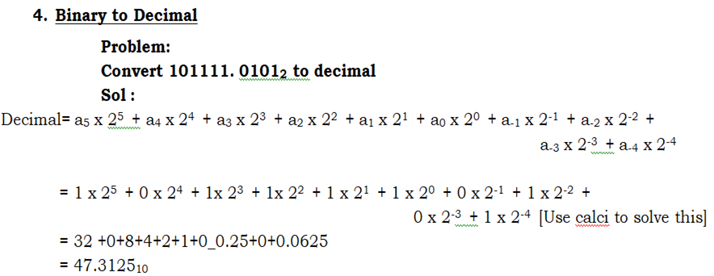

Slide 6
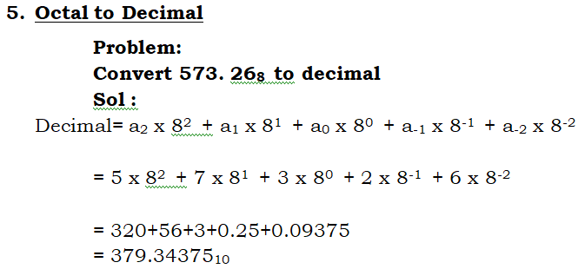
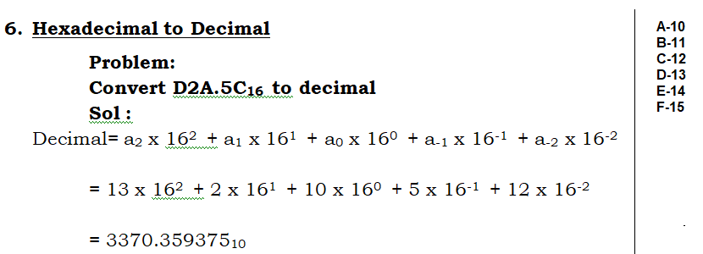

Slide 7
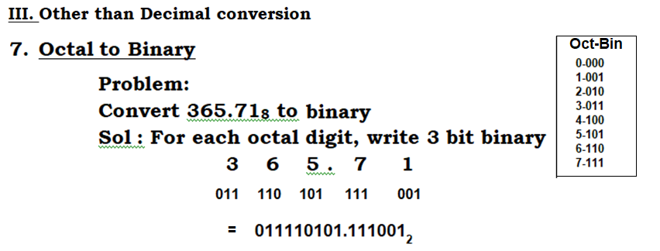
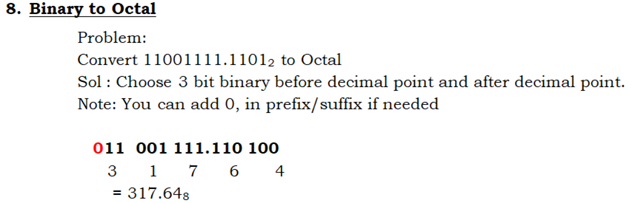

Slide 8
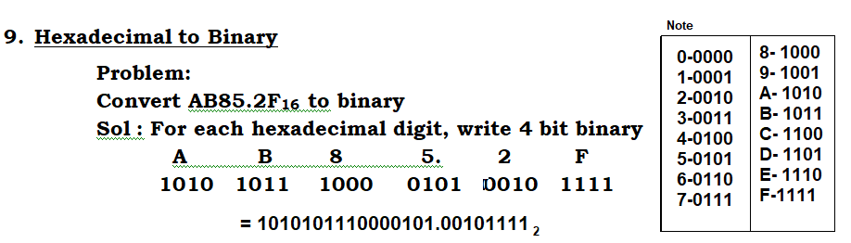
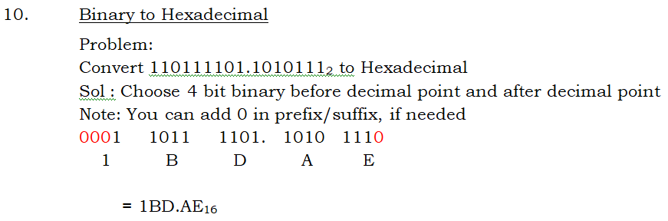

Slide 9
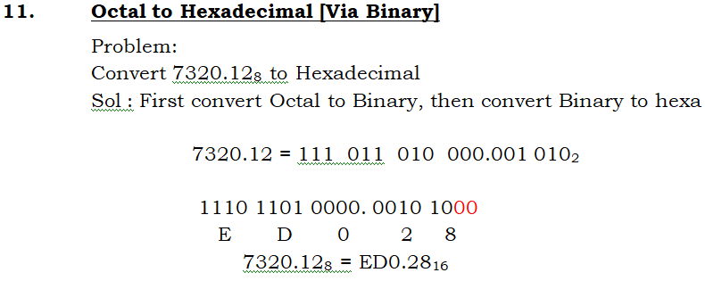
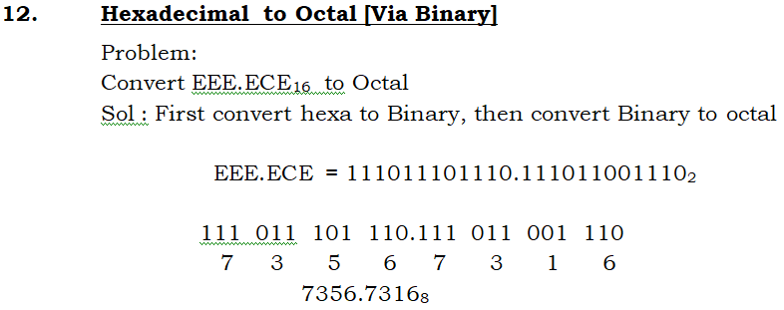

Slide 10
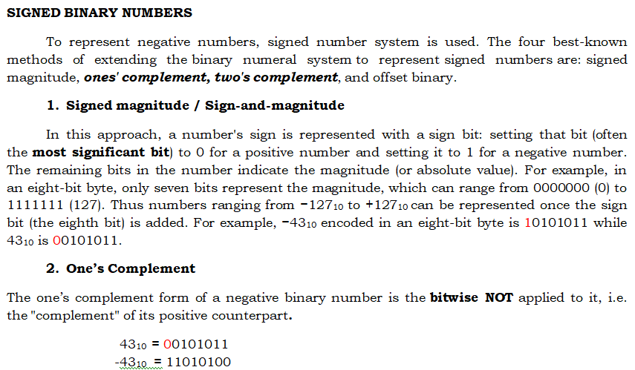

Slide 11
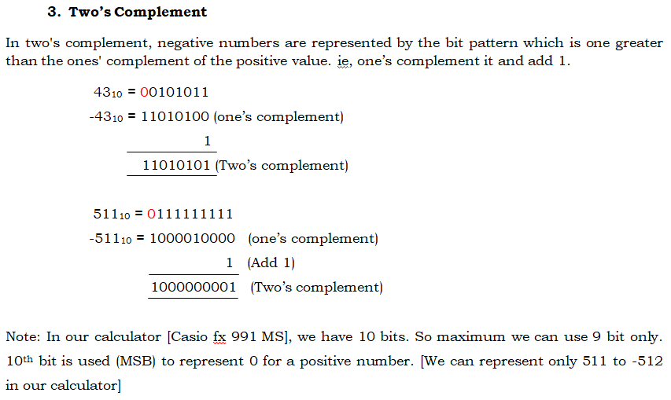

Slide 12
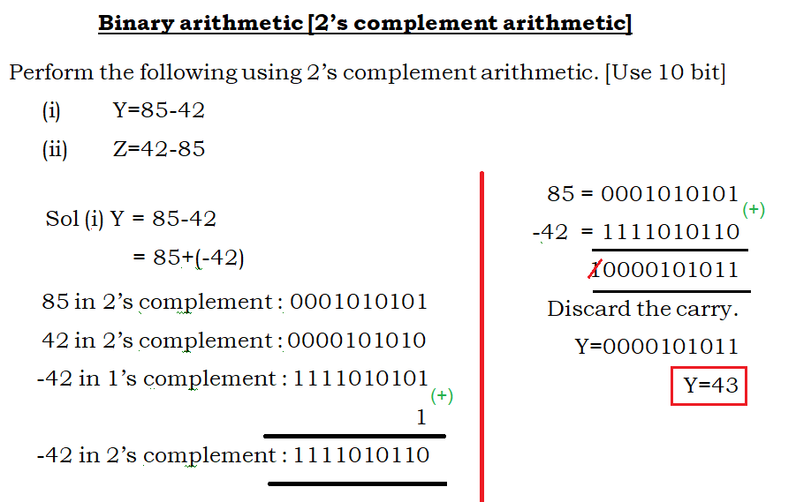

Slide 13
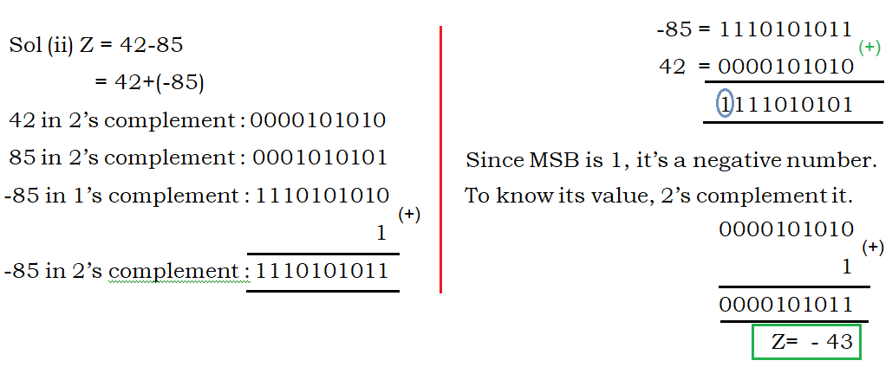

Slide 14
Why Binary used in Digital system
Digital system use binary - the bits 0 and 1 - to store/process data. The circuits in Digital system are made up of billions of transistors. A transistor is a tiny switch that is activated by the electronic signals it receives.
The digits 1 and 0 used in binary reflect the on and off states of a transistor.

Slide 15
BCD CODES
Human can understand and use decimal number easily. But Digital system can understand only binary numbers. So, to interface among human and Digital system, BCD codes were developed. There are many types of BCD codes that were introduced by Scientist. But 8421 code is very much popular and widely used.
8421 code is a 4 bit BCD code having codes for 0 to 9 (Decimal Numbers). Each decimal digit represents 4 bit binary. It obeys positional weightage principle. It’s easy to understand and remember because it’s a normal 4 bit binary number from 0 to 9.

Slide 16
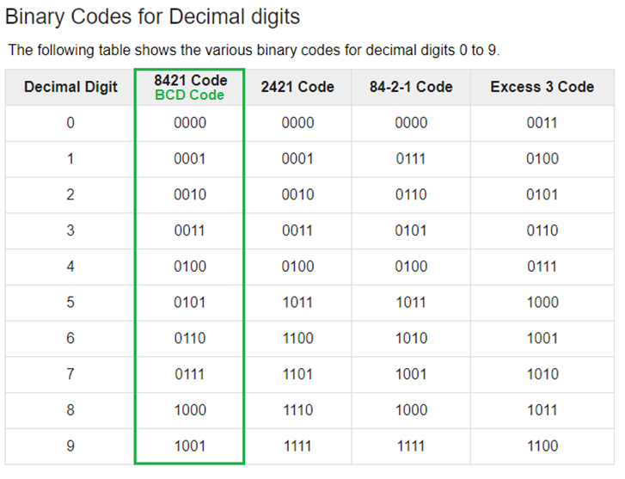
BINARY CODES FOR DECIMAL-BCD

Slide 17
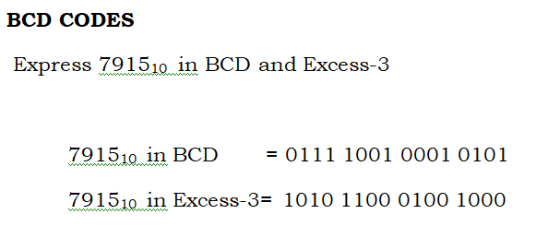
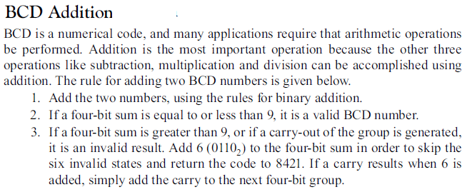

Slide 18
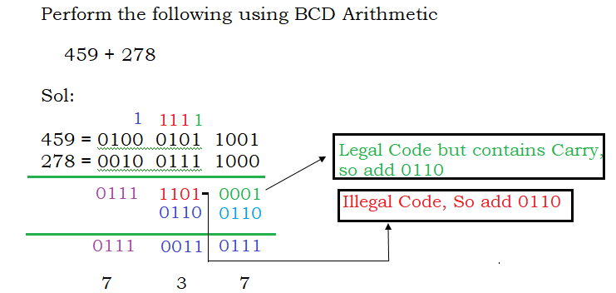

Slide 19
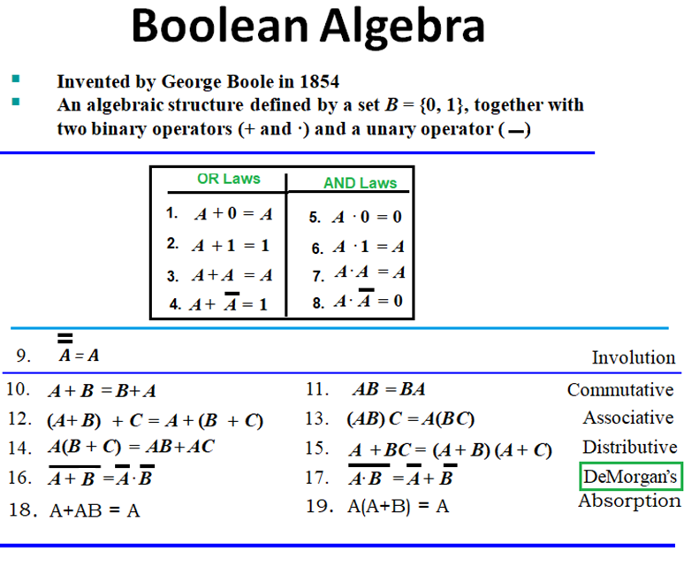

Slide 20
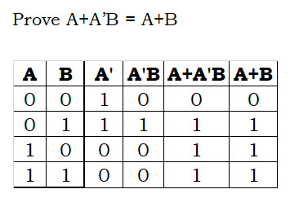


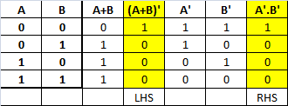
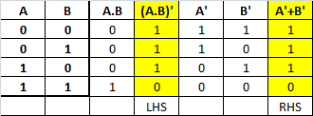

Slide 21
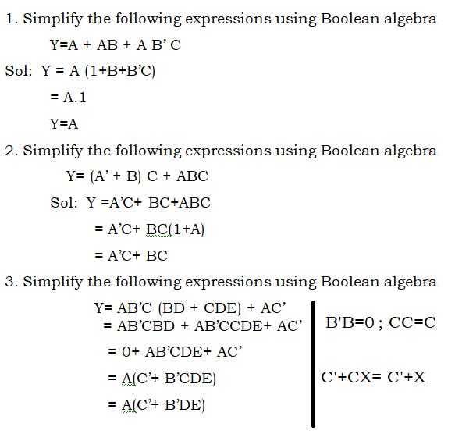
Simplification of Boolean expressions using Boolean algebra

Slide 22
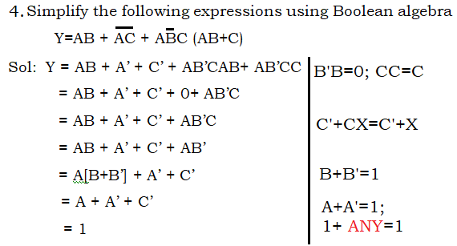
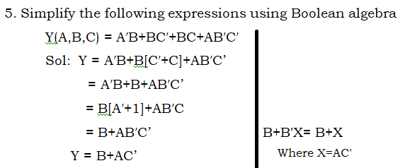

Slide 23
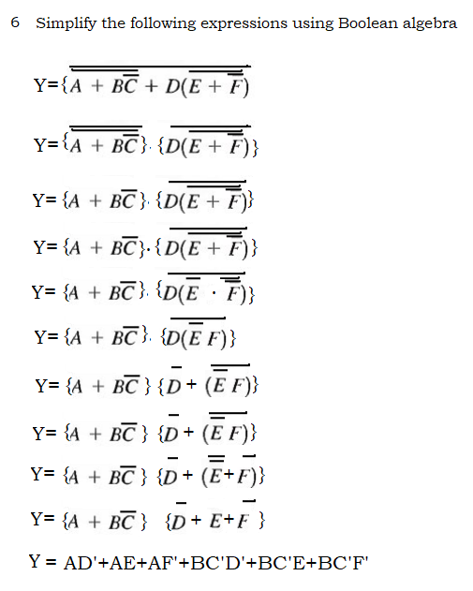

Slide 24
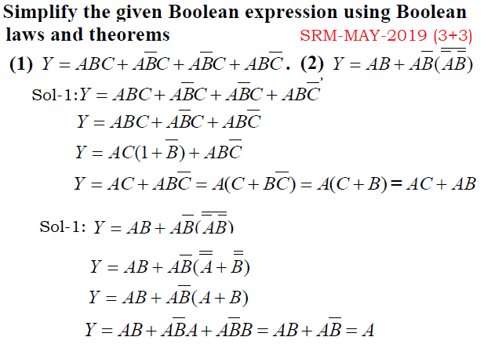

Slide 25
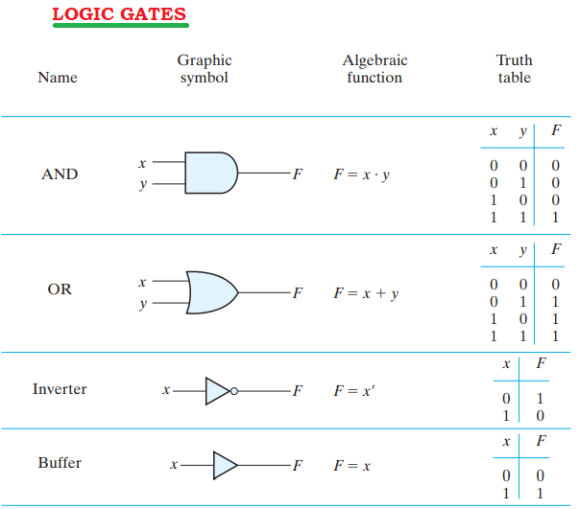

Slide 26
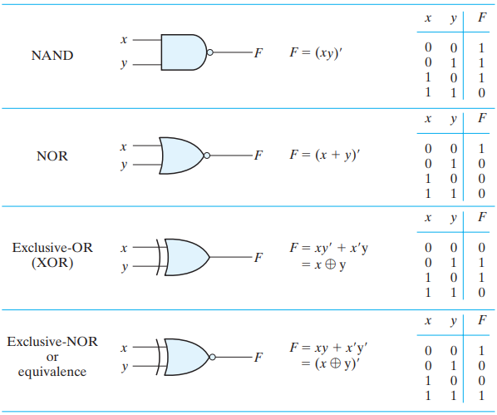

Slide 27
SUM OF PRODUCTS [SOP] AND PRODUCT OF SUMS [POS]
Logical functions (Boolean expression) are generally expressed in terms of logical variables (inputs) in following forms. (Each input variable can have the value, either 0 or 1 only)
SUM OF PRODUCTS [SOP] Ex: AB’+ BC+C’D
PRODUCT OF SUMS [POS] Ex: (A’+B’) (B’+C) (C’+D)
MINTERMS
A product term containing all the inputs of the functions in either complemented or uncomplemented form is called MINTERMS.
Let us consider 3 variable (input) function. It has 2³ all possible combinations. [A ‘n’ variable (input) function has 2^{n} all possible combinations]. Let the inputs are A, B, C and output is Y.

Slide 28
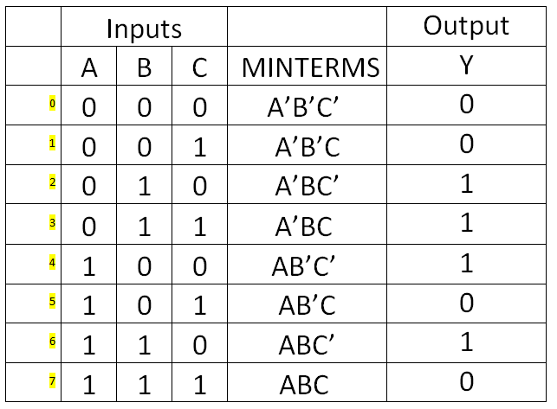
TRUTH TABLE

Slide 29
In minterms, 0 are assigned with bar letter and
1 are assigned with unbar letter.
Within the row, all are multiplied (Product)
Choose only the output 1.
Add the minterms which having 1 output.
In this example, we get Y= A’BC’ + A’BC+ AB’C’+ ABC’. This expression is called canonical SOP form. [Standard SOP form]
Each input is assigned with it equivalent decimal value. In the truth table, only the output Y= 1 is chosen, it corresponding input’s decimal values are stated as below.
Y= ∑m (2,3,4,6)

Slide 30
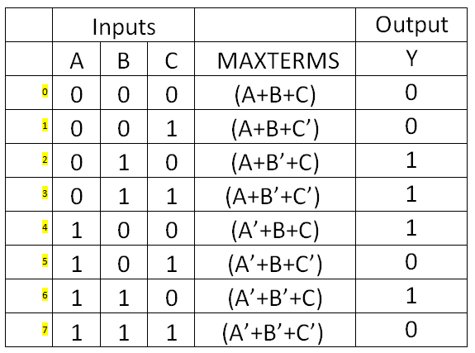
MAXTERMS
A sum term containing all the inputs of the functions in either complemented or uncomplemented form is called MAXTERMS. Let us consider the same truth table.

Slide 31
In maxterms, 1 are assigned with bar letter and
0 are assigned with unbar letter.
Within the row, all are summed (Added)
Choose only the output 0.
Product the maxterms which having 0 output.
In this example, we get Y= (A+B+C) (A+B+C’) (A’+B+C’) (A’+B’+C’). This expression is called canonical POS form. [Standard POS form]
Each input is assigned with it equivalent decimal value. In the truth table, only the output Y= 0 is chosen, it corresponding input’s decimal values are stated as below.
Y= ∏M (0,1,5,7)

Slide 32
1. For the Boolean function given below, obtain the (i) canonical SOP form (ii) canonical POS form.
Y(A,B,C)= A+B’C
= AXX+ XB’C
= AB’C’+ AB’C+ ABC’+ ABC+A’B’C+ AB’C
[Remove the common term; Since A+A=A ]
Y= AB’C’+ AB’C+ ABC’+ ABC+A’B’C [Canonical
SOP form]
100 101 110 111 001
(m₄ m₅ m₆ m₇ m₁)
Y= ∑m (1,4,5,6,7)
Y= ∏M (0,2,3) [ Minterms and Maxterms are complement with each other]
M₀ M₂ M₃
000 010 011
Y= (A+B+C) (A+B’+C) (A+B’+C’) [Canonical POS form]

Slide 33
Karnaugh maps/ K-map
If the number of input variables is more than 2, its very difficult to minimize the Boolean function by Boolean algebra. Karnaugh maps/ K map overcomes this difficulty.
Karnaugh maps/ K map
A visual way to simplify logic expressions
It gives the most simplified form of the expression
K-Maps are a graphical technique used to simplify a logic equation.
K-Maps can be used for any number of input variables, BUT are only practical for two, three, and four variables

Slide 34
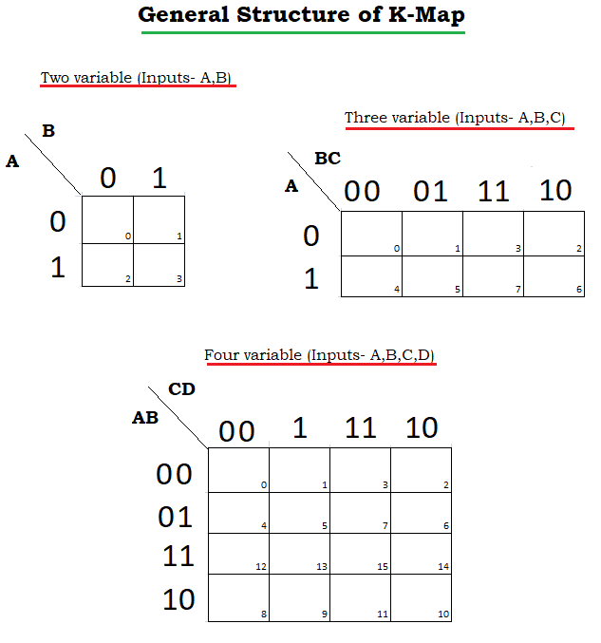

Slide 35
Procedure to minimize Boolean expression by K-map:
1. We have to cheek, number of variables (Inputs).
(i)If the maximum number in the Boolean expression is ≤3, it is 2 variable function.
(ii)If the maximum number in the Boolean expression is ≤7, it is 3 variable function.
(iii)If the maximum number in the Boolean expression is ≤15, it is 4 variable function.
Note: Some times, in the question itself, inputs will be given. Ex: Y(A,B,C)=∑(0,4,5,7)
2. Check the given question is Minterms or Maxterms. If ∑ is given, it is Minterms. In K-map, for the given decimal location, we have to enter 1. In remaining location, we have to enter 0.
If ∏ is given, it is Maxterms. In K-map, for the given decimal location, we have to enter 0. In remaining location, we have to enter 0.
3. Draw the K-map and fill it. (use step 1 & 2)

Slide 36
4 (a) Solution Procedure for SOP method
(i) We have box ALL the 1.
(ii) Larger the box, smaller the equation. Since all are minimization problem, we have chose larger box.
(iii) The number of 1’s inside the box must be 2^{n}. [ie we have to try boxing 16 , if not possible we have to try boxing 8, if not possible we have to try boxing 4, if not possible we have to try boxing 2, if not possible we have to box 1]
(iv) The shape of the box must
be square or rectangular. ie
(v) For each box, we have to find unchanged input.
For that, we have see K-map from right to left, then bottom to top. The unchanged input within the box should be product. The product of one box should be sum with next box.[In input, 0 are assigned with bar letter and 1 are assigned with unbar letter]
(vi) Overlapping is allowed to make larger box.

Slide 37
4 (b) Solution Procedure for POS method
(i) We have box ALL the 0.
(ii) Larger the box, smaller the equation. Since all are minimization problem, we have chose larger box.
(iii) The number of 0’s inside the box must be 2^{n}. [ie we have to try boxing 16 , if not possible we have to try boxing 8, if not possible we have to try boxing 4, if not possible we have to try boxing 2, if not possible we have to box 1]
(iv) The shape of the box must
be square or rectangular. ie
(v) For each box, we have to find unchanged inputs.
For that, we have see K-map from right to left, then bottom to top. The unchanged input within the box should be summed. The sum of one box should be product with next box.[In input, 1 are assigned with bar letter and 0 are assigned with unbar letter]
(vi) Overlapping is allowed to make larger box.

Slide 38
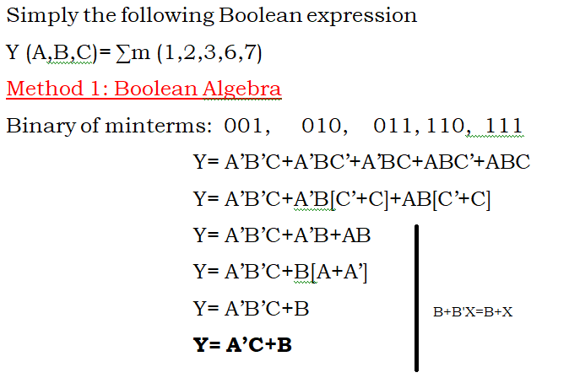
K-MAP-SOP METHOD
1

Slide 39
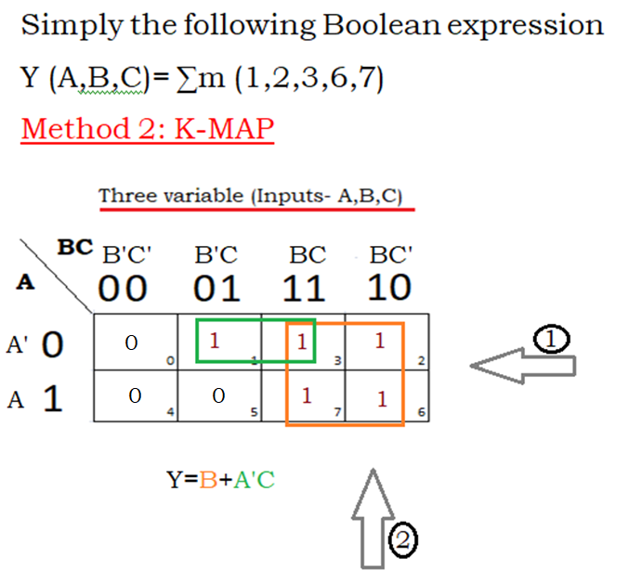
1

Slide 40
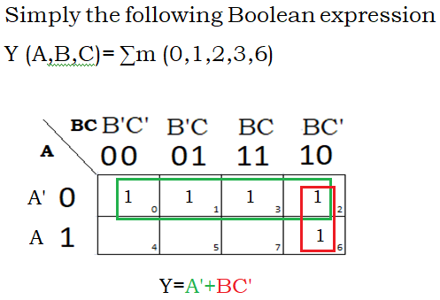
2

Slide 41
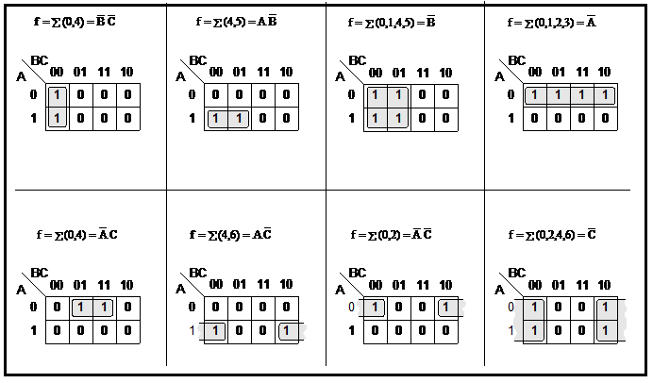
Three-Variable K-Map : Examples

Slide 42
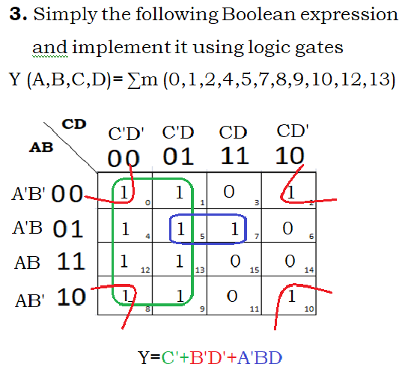

Slide 43
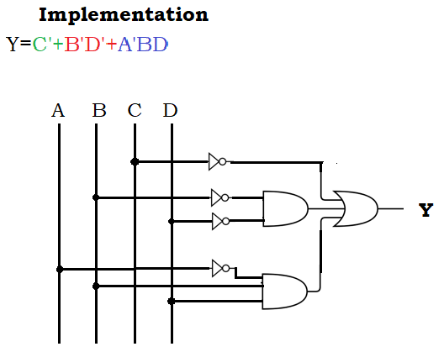

Slide 44
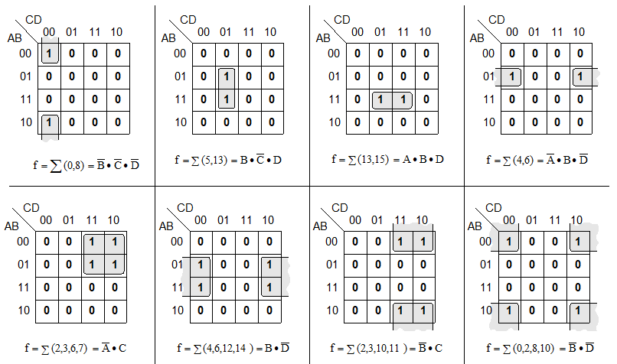
Four-Variable K-Maps Examples

Slide 45
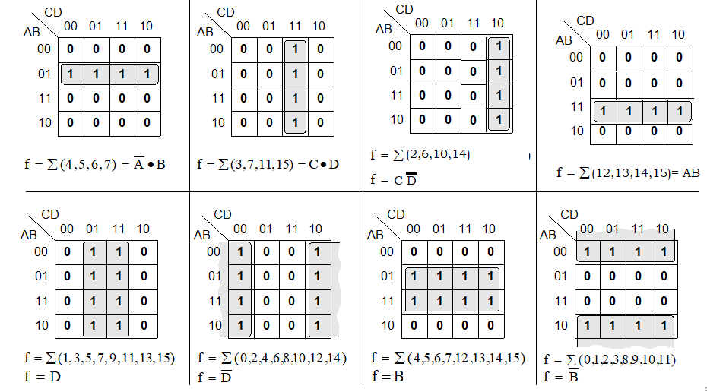
Four-Variable K-Maps Examples

Slide 46
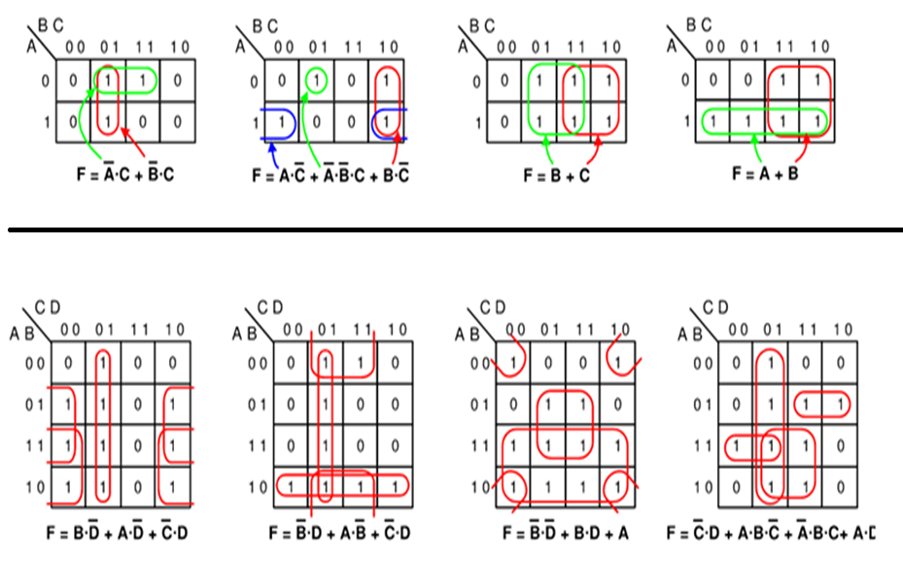
3,4-Variable K-Maps Examples

Slide 47
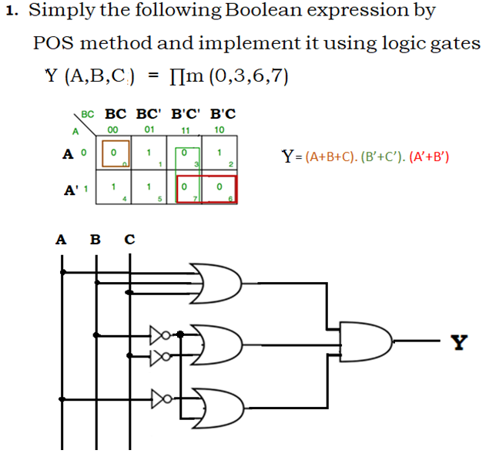
K-MAP-POS METHOD

Slide 48
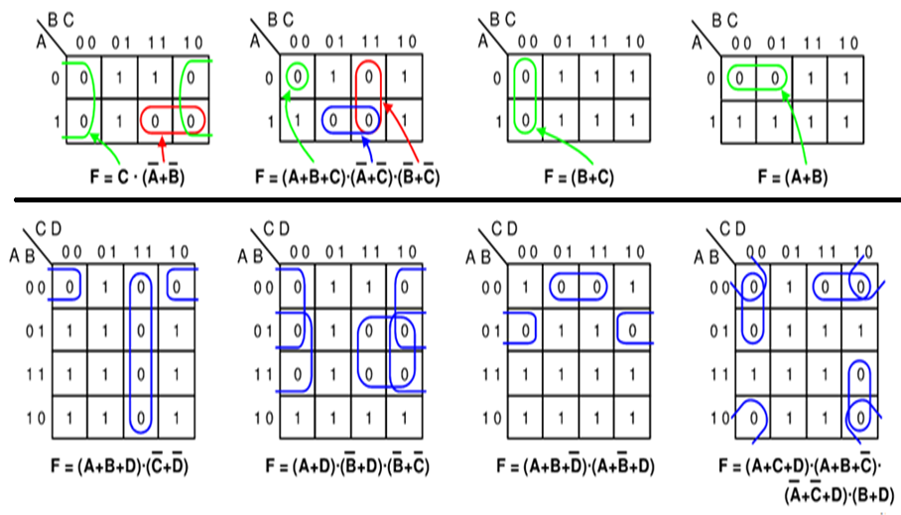
3,4-Variable K-Maps Examples [POS]

Slide 49
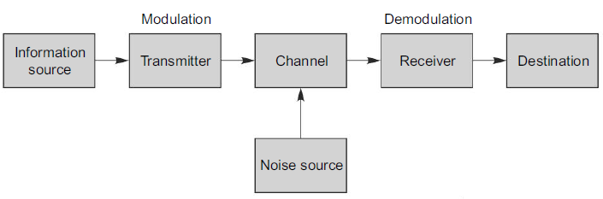
COMMUNICATION SYSTEMS
Communication is a process of transfer of information bearing signals from one place to another. The equipment that transmits the information is the transmitter and the equipment that receives the information is the receiver. Channel is the medium through which the signal travels from the transmitter to the receiver. Telegraphy, telephony, facsimile, radio broadcast, TV transmission and computer communication are a few examples of communication services.
Block Diagram of Communication System
The basic function of a communication system is to communicate a message. The block diagram of a communication system is shown

Slide 50
The information to be transmitted is given by the information source. In most of the cases, the information will be non-electrical in nature. For example, audio signals in speech transmission and picture signals in television transmission. This information in the original form is converted into a corresponding electrical variation known as the message signal by using a transmitter. This message signal cannot be directly transmitted due to various reasons. Hence this message signal is superimposed on a high frequency carrier signal before transmission. This process is referred to as modulation.
After modulation, the modulated carrier is amplified by using power amplifiers in the transmitter and fed to the transmitting antenna. Channel is a medium through which the signal travels from the transmitter to the receiver. There are various types of channels, such as the atmosphere for radio broadcasting, wires for line telegraphy and telephony and optical fibers for optical communication.

Slide 51
As the signal gets propagated through the channel, it is attenuated by various mechanisms and affected by noise from the external source. Noise is an unwanted signal that interferes with the reception, of wanted signal. Noise is usually of random nature and in the design of communication system, careful attention should be paid to minimize the effect of noise on the reception of wanted signals.
At the receiving end, a weak modulated carrier that is transmitted from the transmitter is received. As the received signal power will be very small, it is first of all amplified to increase the power level and the process of demodulation is done to recover the original message signal from the modulated carrier. The recovered message signal is further amplified to drive the output transducer such as a loud speaker or a TV receiver.

Slide 52
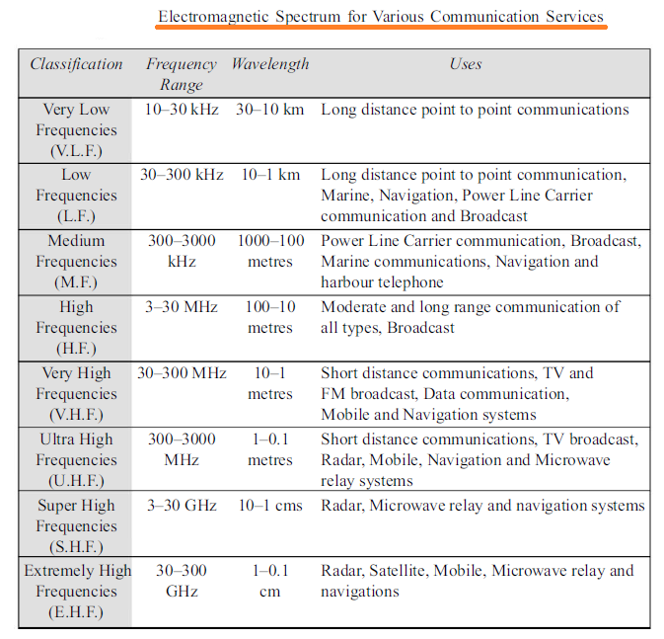

Slide 53

BASIC PRINCIPLES OF MODULATION
Modulation is the process of changing some parameter of a high frequency carrier signal in accordance with the instantaneous variations of the message signal. The carrier signal has a constant amplitude and frequency. The function of a carrier signal is to carry the message signal and hence the name. The message or modulating signals are low frequency audio signals which contain the information to be transmitted. Generally message signal ranges from 20 Hz to 20 kHz.

Slide 54

Amplitude modulation (AM) is a modulation technique used in electronic communication, most commonly for transmitting messages with a radio carrier wave. In amplitude modulation, the amplitude (signal strength) of the carrier wave is varied in proportion to that of the message signal, such as an audio signal.

Slide 55
In amplitude modulation, the amplitude or strength of the carrier oscillations is varied. For example, in AM radio communication, a continuous wave radio-frequency signal (a sinusoidal carrier wave) has its amplitude modulated by an audio waveform before transmission. The audio waveform modifies the amplitude of the carrier wave and determines the envelope of the waveform. In the frequency domain, amplitude modulation produces a signal with power concentrated at the carrier frequency and two adjacent sidebands. Each sideband is equal in bandwidth to that of the modulating signal, and is a mirror image of the other. Standard AM is thus sometimes called "double-sideband amplitude modulation" (DSBAM). Single-sideband amplitude modulation.
A disadvantage of all amplitude modulation techniques, not only standard AM, is that the receiver amplifies and detects noise and electromagnetic interference in equal proportion to the signal. AM broadcast is not favored for music and high fidelity broadcasting, but rather for voice communications and broadcasts (sports, news, talk radio etc.).
AM is also inefficient in power usage; at least two-thirds of the power is concentrated in the carrier signal.

Slide 56

Frequency modulation (FM) is the encoding of information in a carrier wave by varying the instantaneous frequency of the wave. The technology is used in telecommunications, radio broadcasting, signal processing, and computing.
In frequency modulation, such as radio broadcasting, of an audio signal representing voice or music, the instantaneous frequency deviation, i.e. the difference between the frequency of the carrier and its center frequency, has a functional relation to the modulating signal amplitude.
Frequency modulation is widely used for FM radio broadcasting.

Slide 57
It is also used in telemetry, radar, seismic prospecting, and monitoring newborns for seizures via EEG, two-way radio systems, sound synthesis, magnetic tape-recording systems and some video-transmission systems. In radio transmission, an advantage of frequency modulation is that it has a larger signal-to-noise ratio and therefore rejects radio frequency interference better than an equal power amplitude modulation (AM) signal. For this reason, most music is broadcast over FM radio.
Frequency modulation and phase modulation are the two complementary principal methods of angle modulation; phase modulation is often used as an intermediate step to achieve frequency modulation. These methods contrast with amplitude modulation, in which the amplitude of the carrier wave varies, while the frequency and phase remain constant.

Slide 58
Phase modulation (PM) is a modulation pattern for conditioning communication signals for transmission. It encodes a message signal as variations in the instantaneous phase of a carrier wave. Phase modulation is one of the two principal forms of angle modulation, together with frequency modulation.
The phase of a carrier signal is modulated to follow the changing signal level (amplitude) of the message signal. The peak amplitude and the frequency of the carrier signal are maintained constant, but as the amplitude of the message signal changes, the phase of the carrier changes correspondingly.
Phase modulation is widely used for transmitting radio waves and is an integral part of many digital transmission coding schemes that underlie a wide range of technologies like Wi-Fi, GSM and satellite television.
PM is used for signal and waveform generation in digital synthesizers, such as the Yamaha DX7, to implement FM synthesis. A related type of sound synthesis called phase distortion is used in the Casio CZ synthesizers.

Slide 59


Slide 60
Demodulation is extracting the original information-bearing signal from a carrier wave. A demodulator is an electronic circuit that is used to recover the information content from the modulated carrier wave. There are many types of modulation so there are many types of demodulators. The signal output from a demodulator may represent, images or binary data.
There are several ways of demodulation depending on how parameters of the base-band signal such as amplitude, frequency or phase are transmitted in the carrier signal. For example, for a signal modulated with a linear modulation like AM , we can use a synchronous detector. On the other hand, for a signal modulated with an angular modulation, we must use an FM demodulator or a PM demodulator. Different kinds of circuits perform these functions.
Many techniques such as carrier recovery, clock recovery, bit slip, frame synchronization, rake receiver, pulse compression, Received Signal Strength Indication, error detection and correction, etc., are only performed by demodulators, although any specific demodulator may perform only some or none of these techniques.

Slide 61
AM demodulators:
An AM signal encodes the information into the carrier wave by varying its amplitude in direct sympathy with the analogue signal to be sent. There are two methods used to demodulate AM signals:
1.The envelope detector is a very simple method of demodulation that does not require a coherent demodulator. It consists of an envelope detector that can be a rectifier (anything that will pass current in one direction only) or other non-linear component that enhances one half of the received signal over the other and a low-pass filter. The rectifier may be in the form of a single diode or may be more complex. Many natural substances exhibit this rectification behavior, which is why it was the earliest modulation and demodulation technique used in radio. The filter is usually an RC low-pass type but the filter function can sometimes be achieved by relying on the limited frequency response of the circuitry following the rectifier. The crystal set exploits the simplicity of AM modulation to produce a receiver with very few parts, using the crystal as the rectifier and the limited frequency response of the headphones as the filter.
2.The product detector multiplies the incoming signal by the signal of a local oscillator with the same frequency and phase as the carrier of the incoming signal. After filtering, the original audio signal will result.

Slide 62
FM demodulators:
The quadrature detector, which phase shifts the signal by 90 degrees and multiplies it with the unshifted version. One of the terms that drops out from this operation is the original information signal, which is selected and amplified.
The signal is fed into a PLL and the error signal is used as the demodulated signal.
The most common is a Foster-Seeley discriminator. This is composed of an electronic filter which decreases the amplitude of some frequencies relative to others, followed by an AM demodulator. If the filter response changes linearly with frequency, the final analog output will be proportional to the input frequency, as desired.
A variant of the Foster-Seeley discriminator called the ratio detector
Another method uses two AM demodulators, one tuned to the high end of the band and the other to the low end, and feed the outputs into a difference amplifier.
Using a digital signal processor, as used in software-defined radio.

